Slide 1

Laser chemical vapor deposition
Presented by the : 3rd Nano Boys

Slide 2
Outlines
Introduction
Mechanism
Components
Types of LACVD
Advantages/Limitations
Applications

Slide 3
Introduction

Slide 4
What is LCVD ?
It is combination of chemical vapor deposition (CVD) used for deposition of materials via localized chemical reaction driven by a focused laser beam.

Slide 5
Mechanism

Slide 6
Precursor Gas: A precursor gas containing the material to be deposited is introduced into the chamber.
Laser Heating: A focused laser beam heats the substrate's surface, causing local decomposition of the precursor gas molecules.
Chemical Reaction: The precursor gas decomposes due to the laser energy, breaking into its constituent elements.
Material Deposition: The decomposed material deposits on the substrate, forming a thin film or microstructure.
Cooling & Solidification: Once the laser is turned off or moved, the deposited material solidifies.

Slide 7
Components

Slide 8
Components
Reaction Chamber
Laser
Precursor Gases
Substrate & Holder
Pressure & Vacuum Control System
Gas Flow and Exhaust System
Monitoring System

Slide 9
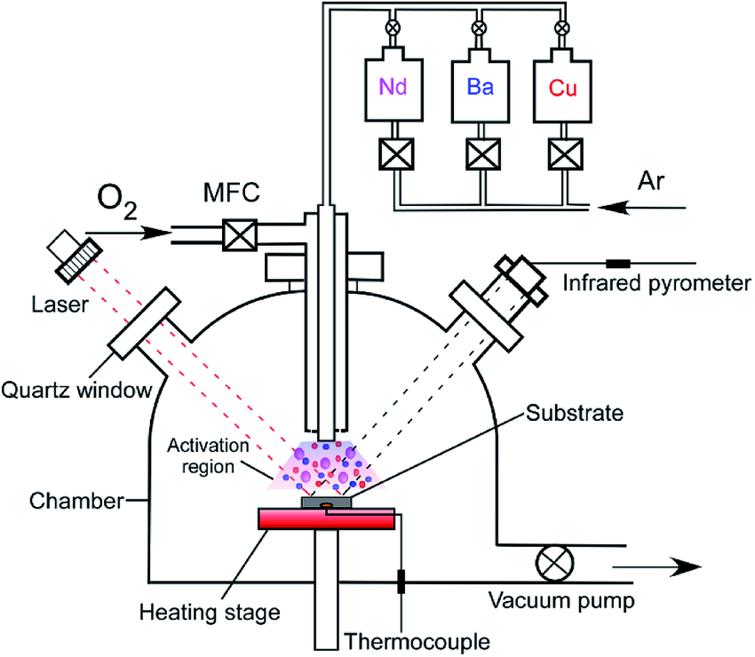
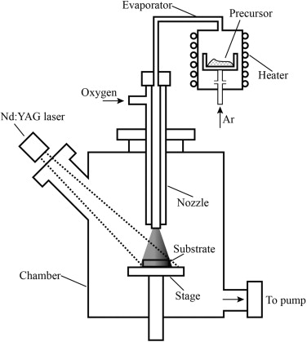
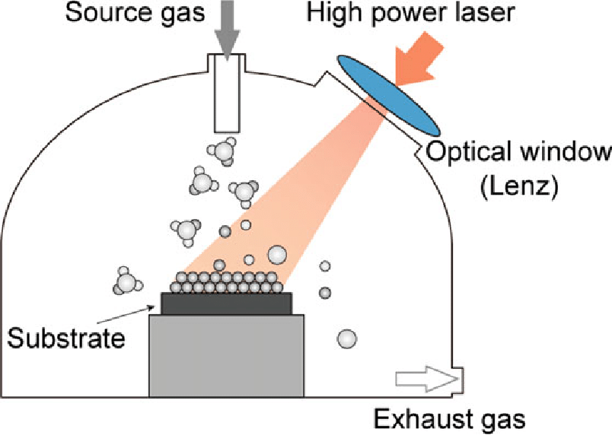

Slide 10
Types of LCVD

Slide 11
Pyrolytic : Thermally-driven reactions in which a focused laser beam is used to locally heat the surface of the substrate to the temperature required for decomposition -continuous wave infrared lasers such as Co2 and Nd:YAG.
Photolytic : Use photons from focused laser beams to directly dissociate reactant gases, resulting in precise deposition of solid material - UV lasers such as Ar+, ArF-193nm , and krF-248nm .

Slide 12
Applications

Slide 13
Applications
Microelectronics : Deposition of semiconductor materials for electronic components.
Coatings and Thin Films : Creation of thin films for protective coatings, and optical coatings
True-3D microstructures by scan patterns and layer-by-layer deposition.

Slide 14
Advantages/Limitations

Slide 15
Advantages
High precision
Layer-by-layer deposition
Disadvantages
Complex in Process Control
Material limitation
No masking required
Small-scale production.

Slide 16
Simulations

Slide 17
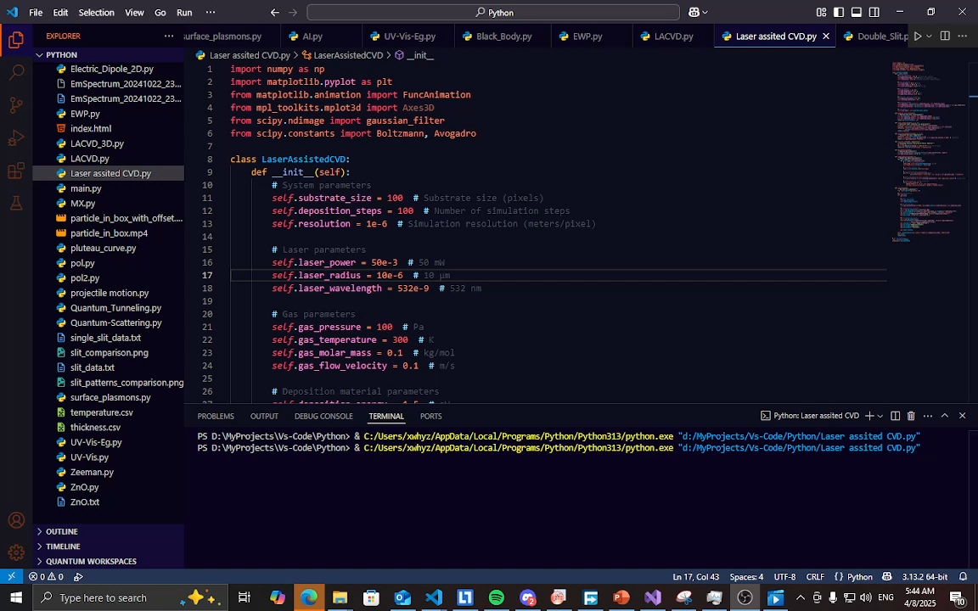

Slide 18
